Slide 1


ANALYSIS OF ANZ TRANSACTIONS FOR THE PERIOD
AUGUST – OCTOBER 2018

Slide 2
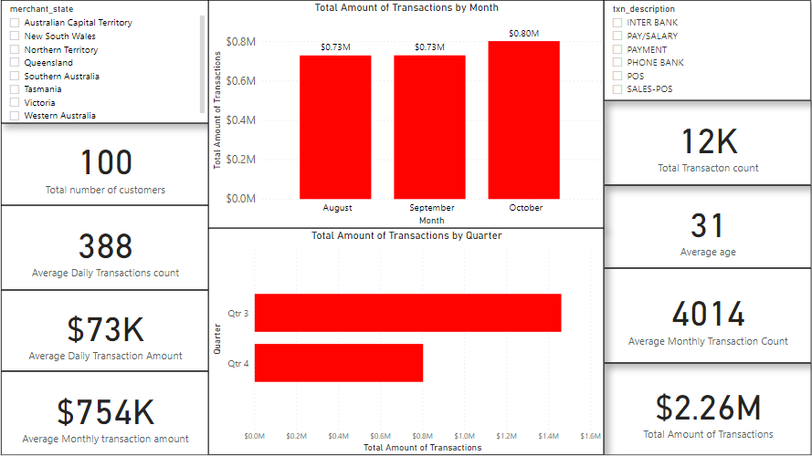
Transaction Summaries

Slide 3
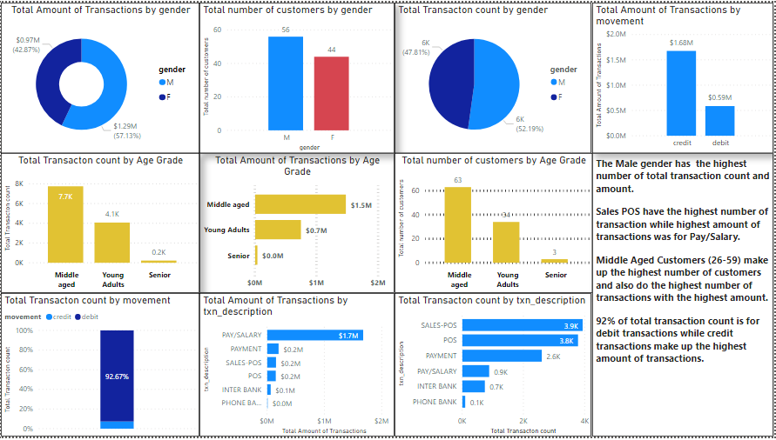

Slide 4
